Slide 1
Design-by-Contract
Design-by-Contract
Carlos D. Rivera
February 28, 2007

Slide 2
WHAT ?
Design-by-Contract (DBC)
is a methodology for designing computer software.

Slide 3
WHAT ?
Design-by-Contract (DBC)
is a methodology for designing computer software.
Define checkable interface specifications

Slide 4
WHAT ?
Design-by-Contract (DBC)
is a methodology for designing computer software.
Define checkable interface specifications
Theory of abstract data types (e.g., interfaces)

Slide 5
WHAT ?
Design-by-Contract (DBC)
is a methodology for designing computer software.
Define checkable interface specifications
Theory of abstract data types (e.g., interfaces)
Metaphor of business contract (e.g., pre-, post-)

Slide 6

HISTORY
Bertrand Meyer

Slide 7
HISTORY
Bertrand Meyer
  Eiffel

Slide 8
HISTORY
Bertrand Meyer
  Eiffel
  Object-Oriented
  Software Construction

Slide 9
HISTORY
Bertrand Meyer
  Eiffel
  Object-Oriented
  Software Construction
  DBC circa 1986

Slide 10
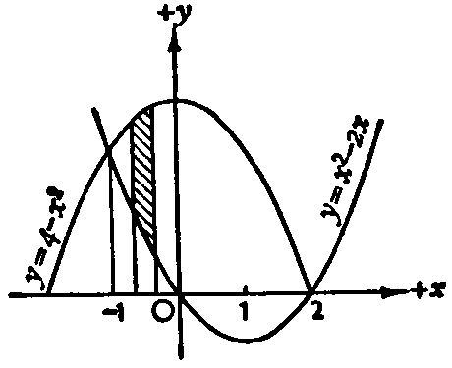
INTRODUCTION
Design-by-Contract is a thinly veiled mathematical proof.

Slide 11
FOUNDATION
Design-by-Contract :

Slide 12
FOUNDATION
Design-by-Contract :
Abstract Mathematical Models of a System
    “this phenomena can be represented by
    this mathematical language”

Slide 13
FOUNDATION
Design-by-Contract :
Abstract Mathematical Models of a System
    “this phenomena can be represented by
    this mathematical language”
Formal Specification
    “this mathematical model will produce this, always”

Slide 14
FOUNDATION
Design-by-Contract :
Abstract Mathematical Models of a System
    “this phenomena can be represented by
    this mathematical language”
Formal Specification
    “this mathematical model will produce this, always”
Formal Verification
    “we can check if the specification is true
    for every case”

Slide 15
OVERVIEW
Object-oriented process commonly implemented
using assertions.

Slide 16
OVERVIEW
Object-oriented process commonly implemented
using assertions.
Assertion benefits:

Slide 17
OVERVIEW
Object-oriented process commonly implemented
using assertions.
Assertion benefits:
Program correctness/testing

Slide 18
OVERVIEW
Object-oriented process commonly implemented
using assertions.
Assertion benefits:
Program correctness/testing
On/off during development

Slide 19
WHY ?
Benefits of DBC :

Slide 20
WHY ?
Benefits of DBC :
Clear design process

Slide 21
WHY ?
Benefits of DBC :
Clear design process
Inheritance

Slide 22
WHY ?
Benefits of DBC :
Clear design process
Inheritance
Exception handling

Slide 23
WHY ?
Benefits of DBC :
Clear design process
Inheritance
Exception handling
Automatic software documentation

Slide 24
HOW ?
Client-Supplier business relationships.

Slide 25
HOW ?
Client-Supplier business relationships.
Basis: | Pre-condition
 | If you have the right amount of money
 | If input values within specified range
 | Expectations

Slide 26
HOW ?
Client-Supplier business relationships.
Basis: | Post-condition
 | You will get this product
 | It will be transformed to this result
 | Guaranteed

Slide 27
HOW ?
Client-Supplier business relationships.
Basis: | Class Invariant
 | Under these conditions
 | Object analysis invariant { assert ( ); }
 | Maintain

Slide 28
CONCLUSION
Analogy :

Slide 29
CONCLUSION
Analogy :
Molds can be used to make copies of objects with negligible variation.

Slide 30
CONCLUSION
Analogy :
Molds can be used to make copies of objects with negligible variation.
Assertions can be used to create validated clones of ADTs of precise definition.

Slide 31
CONCLUSION
Even though Design-by-Contract may seem straight-forward and almost routinely basic, its importance lies in its power to create a type of mutually agreed upon business contract, equally understandable to both the client and developer, that scientifically maps a problem-solving mathematical model to the client’s needs.

Slide 32
CONCLUSION
Most importantly, the documentation provided by DBC creates a contract whereby requirements can be specified and met without avail.

Slide 33
CONCLUSION
Questions, Concerns, Complaints ?
Most importantly, the documentation provided by DBC creates a contract whereby requirements can be specified and met without avail.

